Slide 1
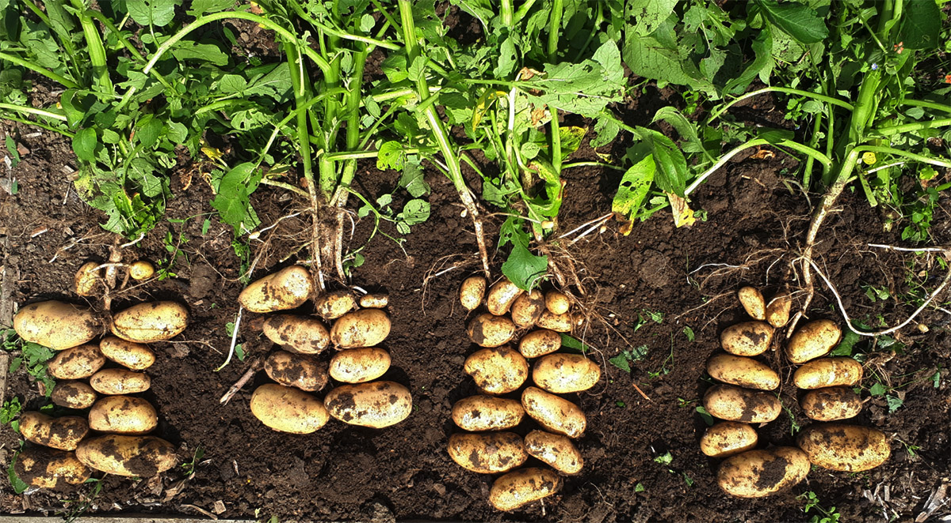

THE Good growth plan 2022
Kenya Potato
Vladimir Eskin veskin@6grain.com
Molly Brown mbrown@6grain.com

Slide 2
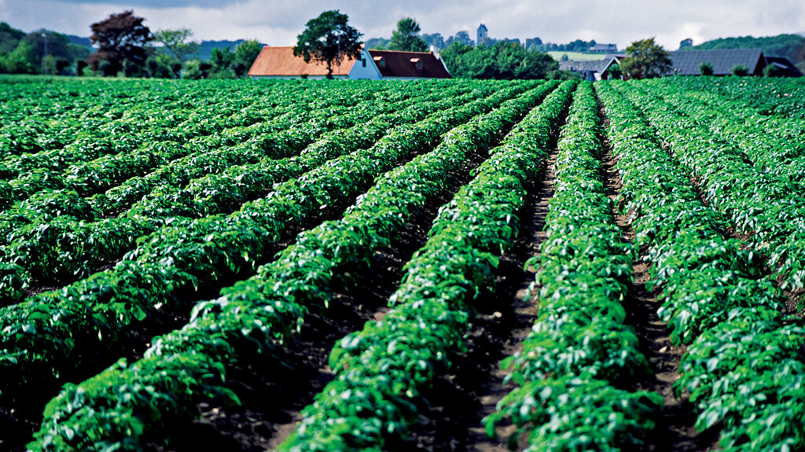
SAMPLE
& SCOPE

Slide 3
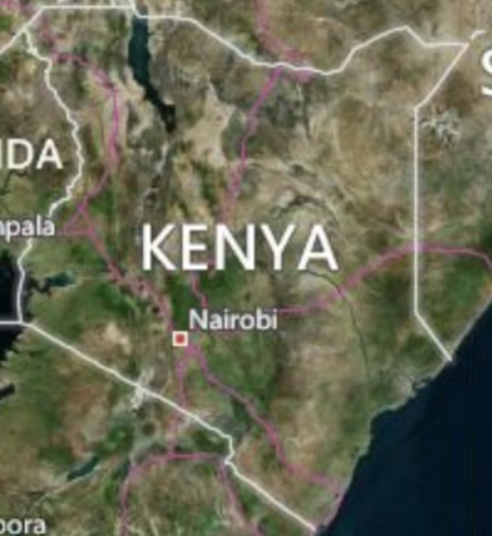
Sample & scope
Survey period:
Planting Season: October to November 2021 (Pre-planting survey)
Harvest Season: March to April 2022 (Post-harvest survey)
Benchmark farms:
Number of fields surveyed: 111
Location: Kiambu, Nyandarua
Farm size: 0.1 – 3.2 hectares
Reference farms:
Number of fields surveyed: 6
Location: Nakuru, Nyandarua
Farm size: 0.4 – 5.3 hectares
Return rate for post-harvest survey:
Benchmark farms: 92 of 111 (83%)
Reference farms: 5 of 6 (83%)

Slide 4
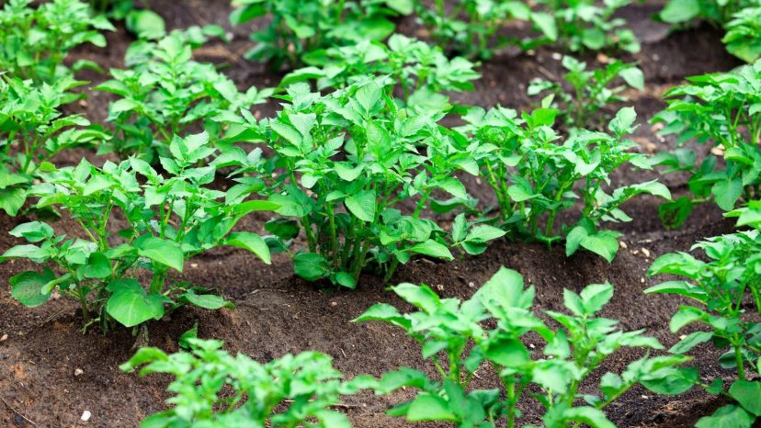
Pre-planting survey

Slide 5
Benchmark farms: farmer basics

Slide 6
Benchmark farms: Crop programs

Slide 7
Benchmark farms: sustainability

Slide 8
Benchmark farms: CROP ROTATION and intercropping

Slide 9
Benchmark farms: soil

Slide 10
Benchmark farms: SOIL OPERATIONS

Slide 11
Benchmark farms: knowledge

Slide 12
Benchmark farms: knowledge (continued)

Slide 13
Benchmark farms: seeds

Slide 14
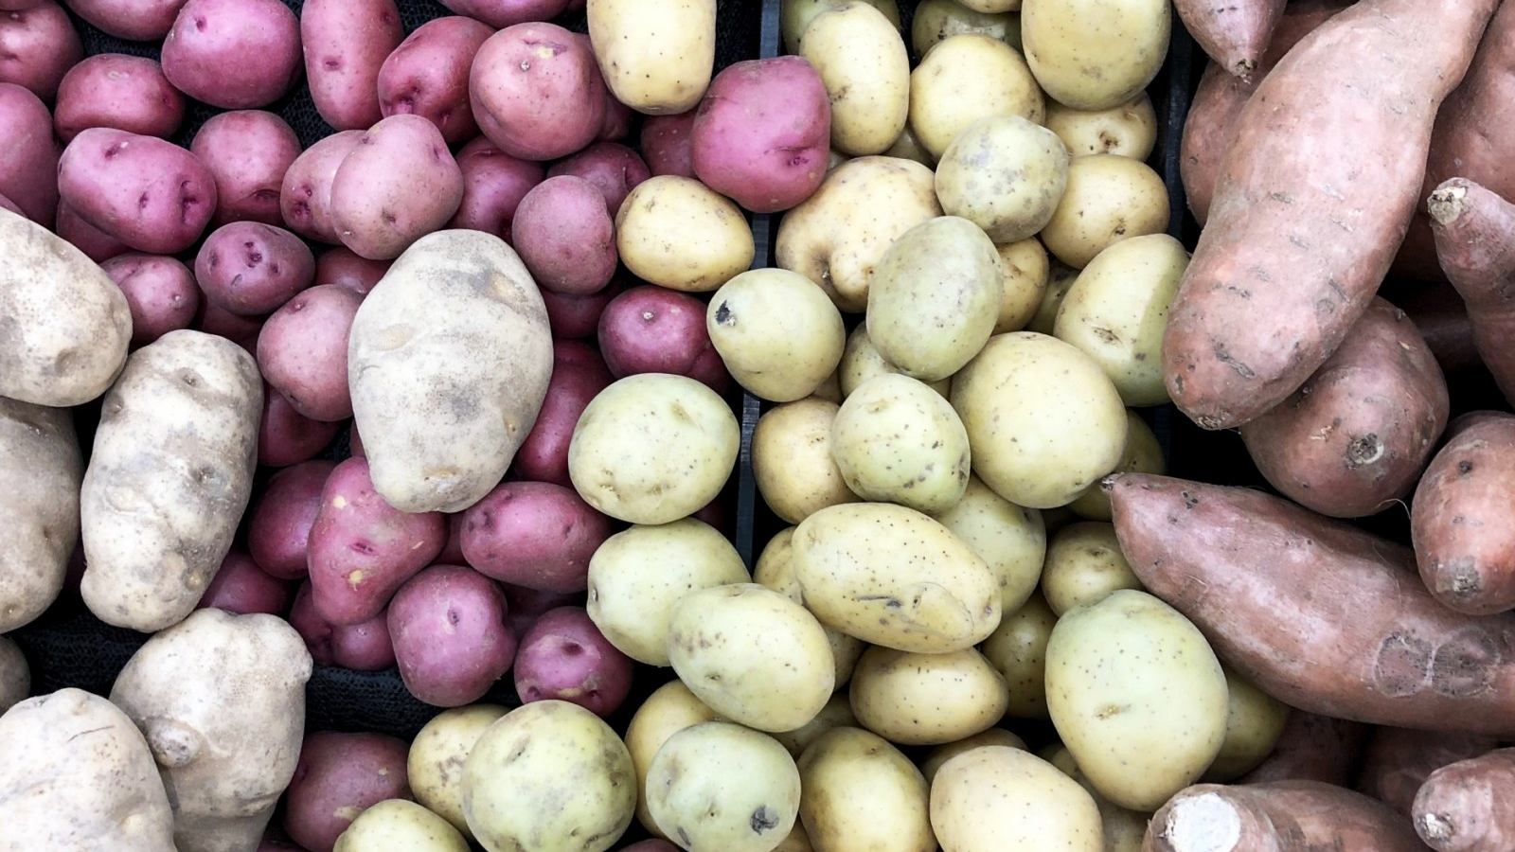
Post-harvest survey

Slide 15
Benchmark farms: growing conditions

Slide 16
Benchmark farms: crop protection use

Slide 17
Benchmark farms: yield

Slide 18
Benchmark farms: crop damages

Slide 19
Benchmark farms: purchasing prices

Slide 20
Benchmark farms: profitability

Slide 21
Benchmark farms: knowledge

Slide 22
Benchmark farms: knowledge (continued)

Slide 23
Benchmark farms: fertilizer application

Slide 24
Benchmark farms: crop-protection product application

Slide 25
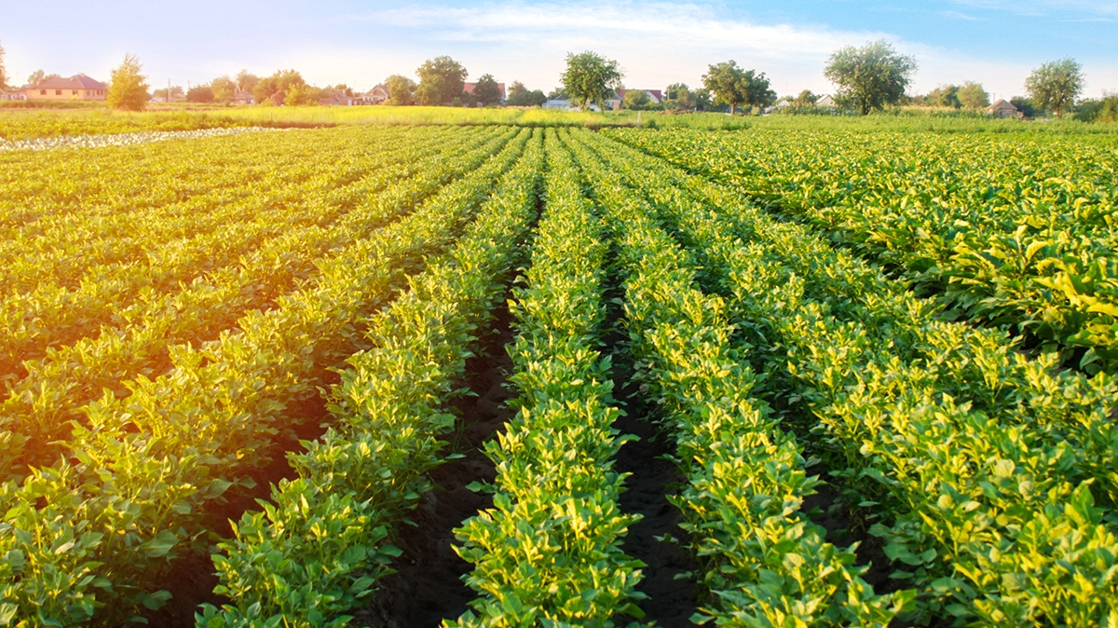
KEY performance indicators

Slide 26
MARKETABLE YIELD, benchmark vs. reference farms
Yield
Benchmark farms
Average = 11.3 tons/ha
50% percentile = 8.5 tons/ha
Reference farms
Average = 13.3 tons/ha
50% percentile = 15 tons/ha

Slide 27
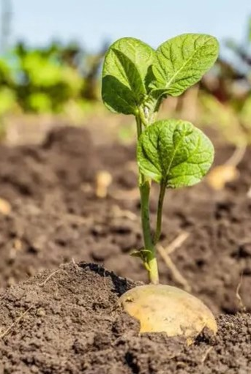
marketable YIELD: benchmark vs. reference farms
kenya POTATO

Slide 28
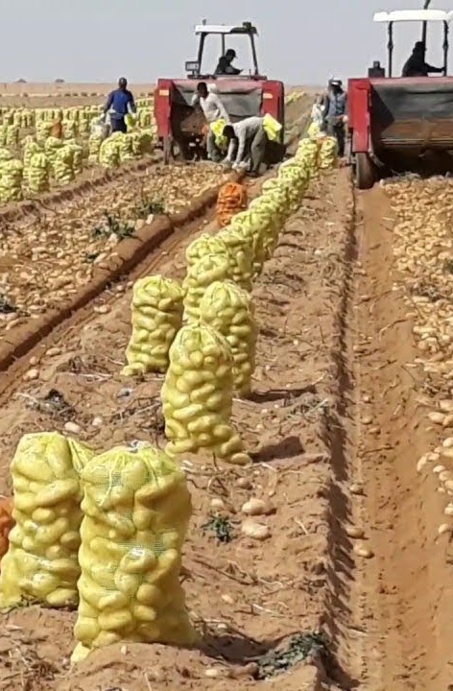
Non-Marketed yield
observations
Yield for future seed use
Surveyees are asked for percentages of:
  Harvested crops that are damaged
  % of yield for own consumption
  % of yield for seeds in future seasons
45 fields saving yield for future seeds
47 fields with 0%
Average yield for future seeds = 12%
Yield for own consumption
Crop damages
47 fields reporting using yield with own consumption
45 fields with 0%
Average own-consumption yield = 8%
90 fields with crop damage
2 fields with 0% crop damage
Average damaged crop = 10%

Slide 29
Non-MARKETed YIELD, benchmark farms

Slide 30
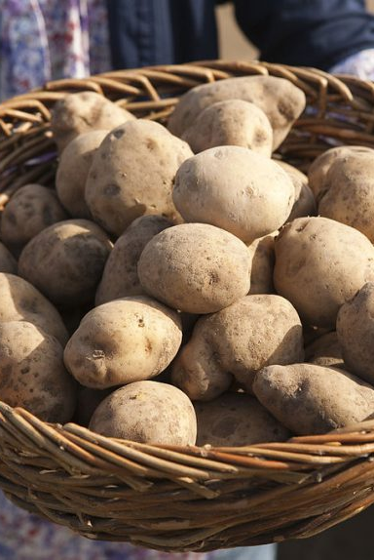
Non-marketed yield: benchmark vs. reference farms
Own Consumption
KENYA potato

Slide 31
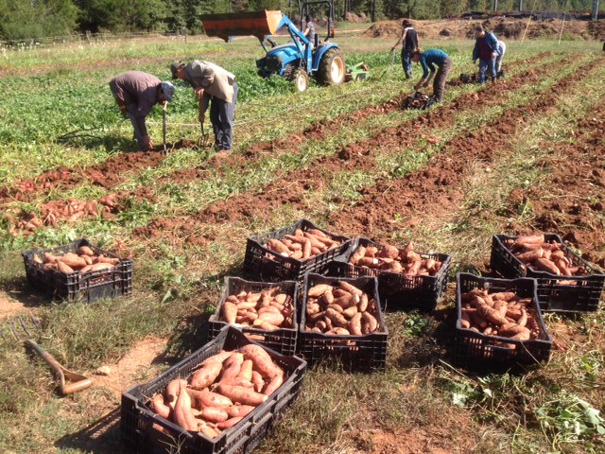
Non-marketed yield: benchmark vs. reference farms
Future seed use
KENYA potato

Slide 32
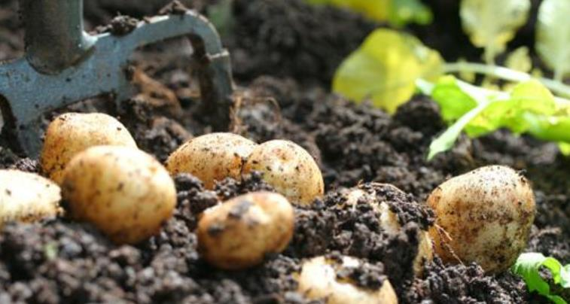
Non-marketed yield: benchmark vs. reference farms
Crop damages
KENYA potato

Slide 33
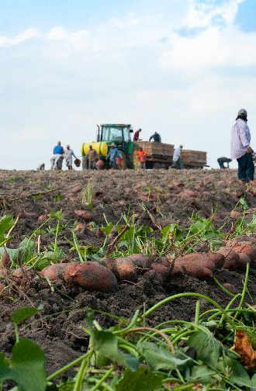
Total amount / investment cost
Number of observations
Response rate
111 fields surveyed
Surveyors are asked about investment cost (USD) in these categories:
  Seeds
  Fertilizers
  Pesticides
  Labor
  Machinery
  Water use
  Fuel
  Electricity
  Gas
  Rent / loans
Response rate varies based on investment category
Top 3 costs
Rent / loans: 124 USD per ha (41%)
Fertilizers: 32 USD (11%)
Seeds: 31 USD (10%)

Slide 34
Total amount / investment cost, benchmark farms
kenya POTATO

Slide 35
Total amount / investment cost, benchmark farms
kenya POTATO

Slide 36
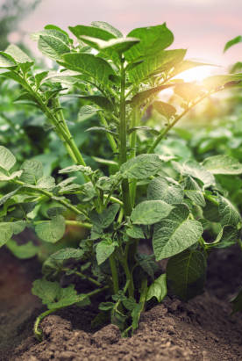
Total amount / investment cost, benchmark farms

Slide 37
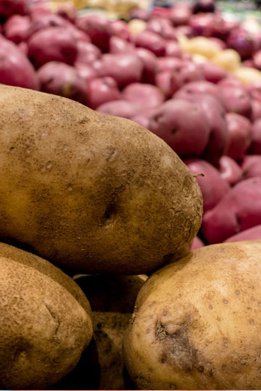
Total amount / investment cost, benchmark farms

Slide 38
Total amount / investment cost, benchmark farms

Slide 39
Total amount / investment cost: benchmark vs. reference farms
kenya POTATO

Slide 40
Total amount / investment cost: benchmark vs. reference farms
kenya POTATO

Slide 41
Total amount / investment cost: benchmark vs. reference farms
kenya POTATO

Slide 42
Total amount / investment cost: benchmark vs. reference farms
kenya POTATO

Slide 43
Total amount / investment cost: benchmark vs. reference farms
kenya POTATO

Slide 44
REVENUE
observations
Responses
Surveyees are asked for their total revenue for the current season
64 fields provide a response, representing a total of 72 thousand dollars of revenue
28 fields with 0 or N.A.
Lowest revenue = 25 USD
Highest revenue = 36,000
50% percentile = 80
Average = 1,133
Median revenue per hectare = 247 USD per hectare

Slide 45
revenue

Slide 46
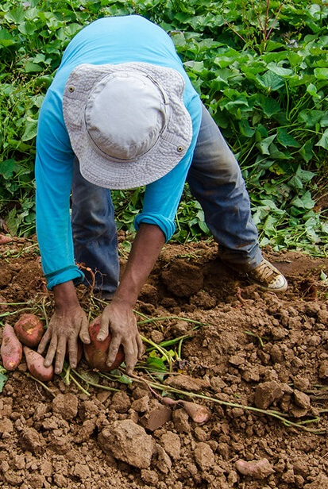
revenue: benchmark vs. reference farms
kenya POTATO

Slide 47
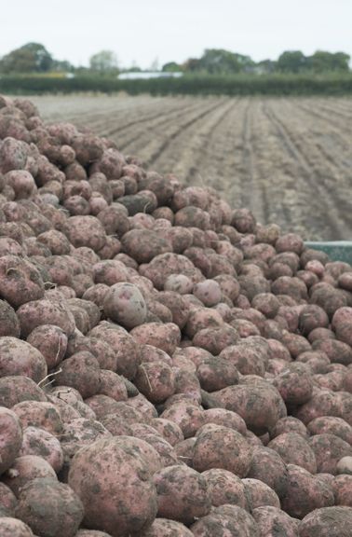
Revenue-cost comparison
observations
outcome
For surveys with both revenue and total cost/investments:
  The comparison (in dollars and in ratio) is computed
Lowest revenue to cost comparison = 1/2 time
Highest = 1,500 times
50% percentile = 1.2 times
Average = 56 times

Slide 48
Revenue-cost comparison, benchmark farms

Slide 49
Revenue-cost comparison: benchmark vs. reference farms, TOTAL USD

Slide 50
Revenue-cost comparison: benchmark vs. reference farms, USD PER HECTARE

Slide 51
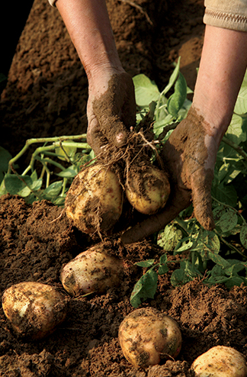
Estimated REVENUE
observations
Response rates
Surveyees are asked to estimate total revenue for the current season
59 fields provide a non-zero estimate
33 fields with estimate = 0 or N.A.
Estimated revenue
The surveyees estimate a total of 389 thousand USD revenue
50% percentile = 70 USD
50% percentile per hectare = 173 USD/ha

Slide 52
Estimated revenue, benchmark farms

Slide 53
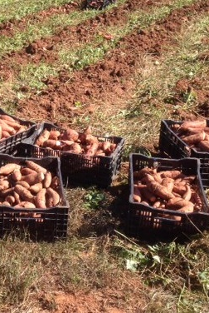
Estimated revenue: benchmark vs. reference farms
kenya POTATO

Slide 54
Crop use
Observations
Response rate
Surveyees are asked the US dollar amount of crops for:
  Own consumption
  Later stage sale
  Animal feed
  By-product use
  Share cropping arrangements
Response rate varies based on crop use category
Top 2 categories
Share cropping arrangements
Later stage sale

Slide 55
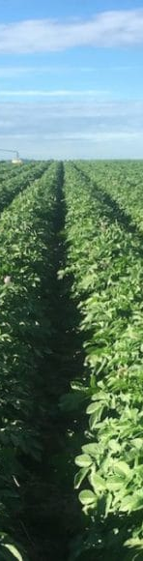
Crop use

Slide 56
CROP USE: Benchmark farms

Slide 57
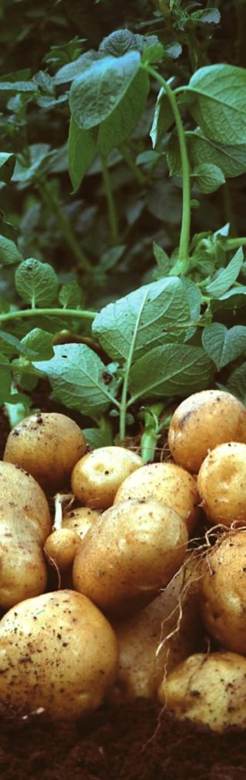
Crop use: benchmark vs. reference farms

Slide 58
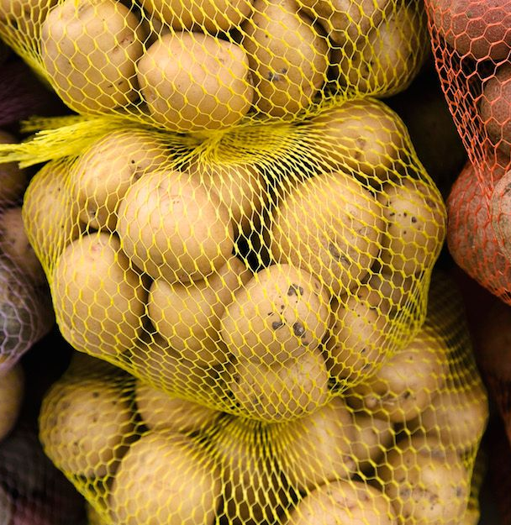
Thank you
Vladimir Eskin
veskin@6grain.com
Molly Brown
mbrown@6grain.com

